Slide 1
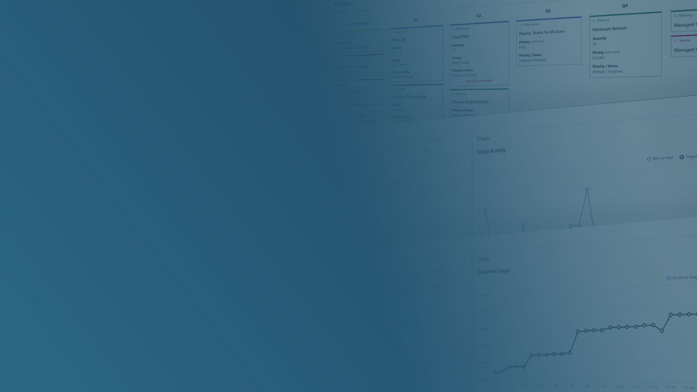

Land a Client with CloudRadial
Ricky Cecchini
Director of Product Services
CloudRadial

Slide 2
What is CloudRadial?​
SaaS solution for MSPs​
For you, CloudRadial is an integrated account management platform that reduces costs, improves sales and client retention​
For your clients, CloudRadial is your branded client portal​
We take what you do and make it transparent and insightful to your clients

Slide 4

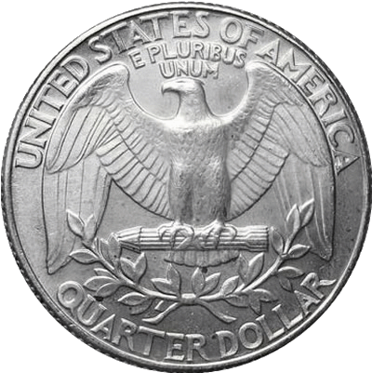
Two Sides to the Client Experience
Client-Facing
IT Provider-Facing

Slide 5
Who is this webinar for?
Those looking to structure and build sales processes
Those looking to enhance existing sales processes
Those looking for a demonstration as to how CloudRadial works

Slide 6
How can CloudRadial help you land more clients?
The main question:

Slide 7
Today’s theme: Trust (or lack thereof).
The Three Modern Truths of Trust:
- Trust is earned.
Trust is proven.
Trust is outdated.
Example: Zero-trust Security

Slide 8
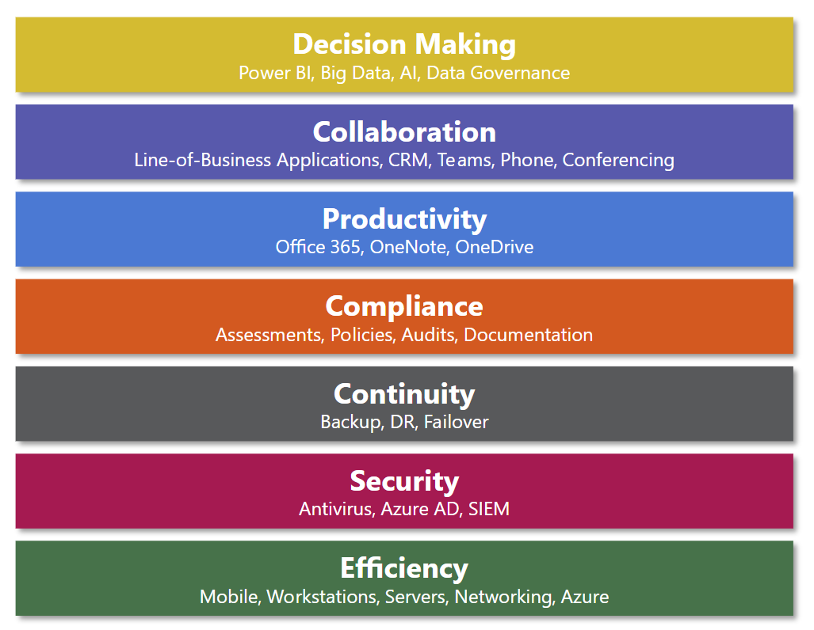
Build an
IT Foundation
Don’t tell, show.
Sets you up for greater things
Sets the stage for things to come
Provides strategy from the get-go

Slide 9
How can we help you succeed?
PDF guide emailed after the webinar is wrapped up.
Follow-up webinar on LOMG (Onboard) tentatively set for April 8th
Additional resources to be added to our website and community as time goes on

Slide 10
Lastly: Academy Training!!!
Yes, I use three exclamation points. I’m not proud of it.
academy.cloudradial.com for training on how to do all of the things shown in this webinar.
Details on how to set up your Academy training can be found via https://radials.io/Training.

Slide 11
Let’s get started.

